Slide 1
Sat-to-Map
Using Neural Network based approaches to form maps from satellite images.
Shagun Uppal (2016088)
Sarthak Bhagat (2016189)

Slide 2
Introduction
We intend to use 3 different types of models : Convolutional neural network, Variational autoencoder and Generative Adversarial network to perform image to image translation.
We input the model with satellite images of different geographical areas and it outputs the map of the region.
We would aim to compare the performance of these methods qualitatively and quantitatively and hence, comment which type of model is best suited for tasks like these.

Slide 3
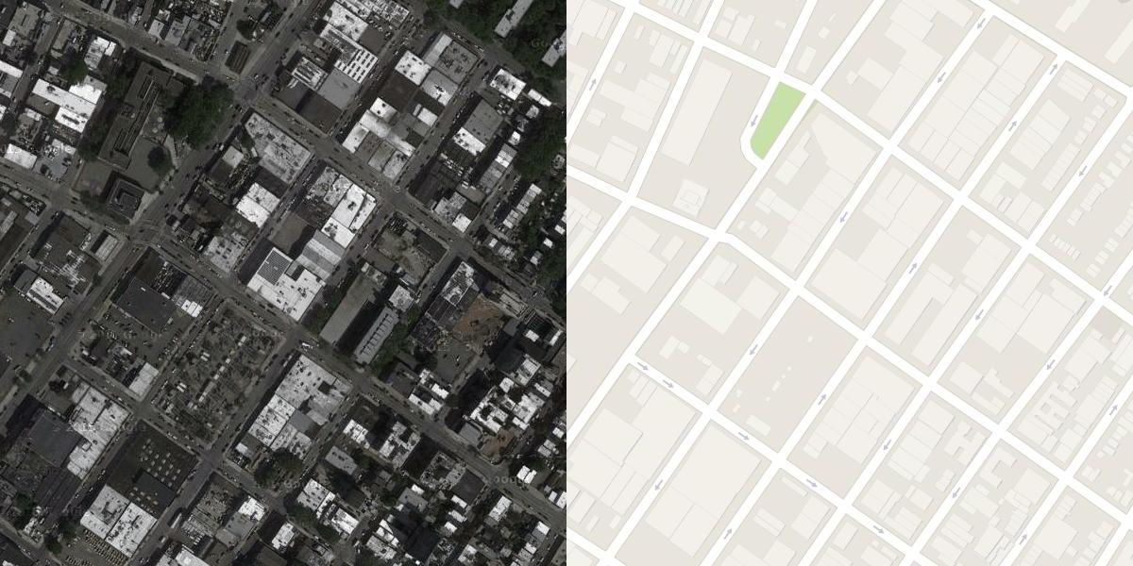
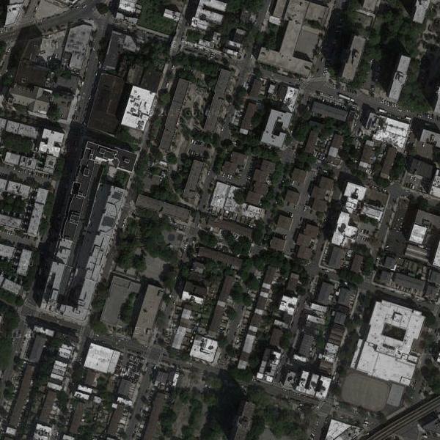
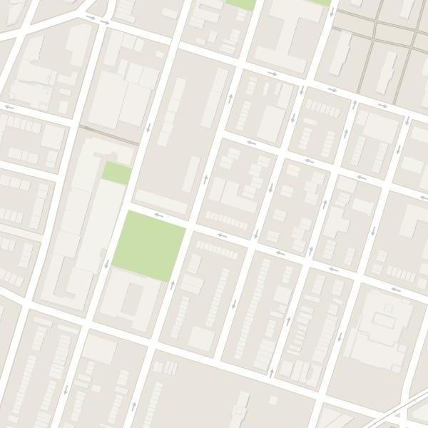
Dataset
We used a dataset available online containing satellite images and their corresponding images of maps stacked side by side.
We preprocess all the data by cropping the satellite image and the map part and divided the entire dataset into train+validation and test set.
All images were also resized and made 128x128 as it was computationally very heavy to work with such large images.

Slide 4
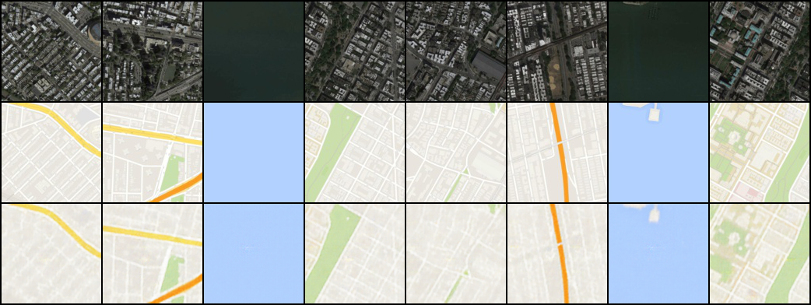
Intermediate results
NETWORK ARCHITECTURE
Generator
5 convolution layers with 5 instance norms, and then 2 linear layers, followed by 5 deconvolution with 5 instance norms
Activation used : ReLU
Discriminator
5 convolution layers with 5 instance norms, followed by one linear layer
Activation used : Leaky ReLU
Convolution Neural Network

Slide 5
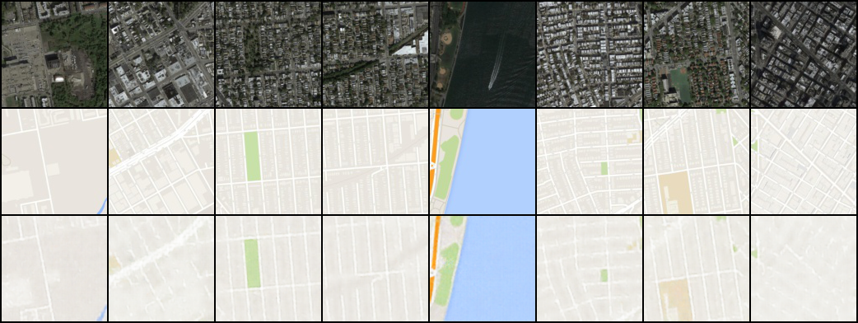
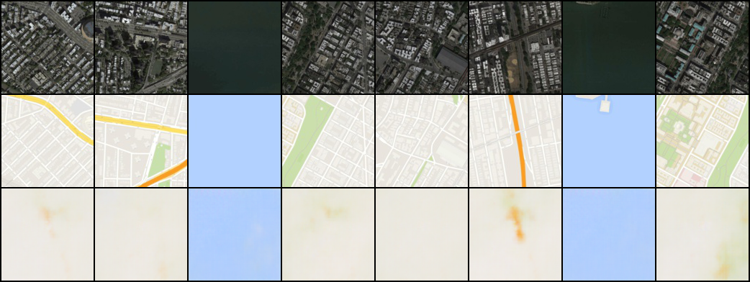
Generative Adversarial Network
Variational Autoencoder

Slide 6
Next steps ...
Debug the training of VAE.
Improve performance of all networks by tuning hyperparameters using K-Fold cross validation by dividing train set as train + validation set.
Plotting train and test losses of each model using Tensorboard, comparing train and test errors to pick the model that best fits the data.
Using different metrics (qualitative and quantitative) proposed in the project proposal to compare performance of various models.

Slide 7
Thank you ...

